Slide 1
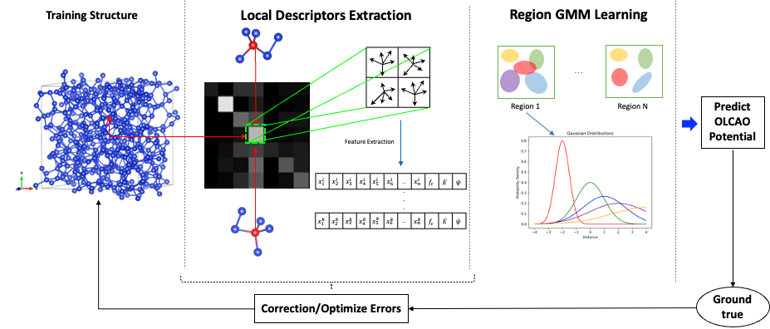
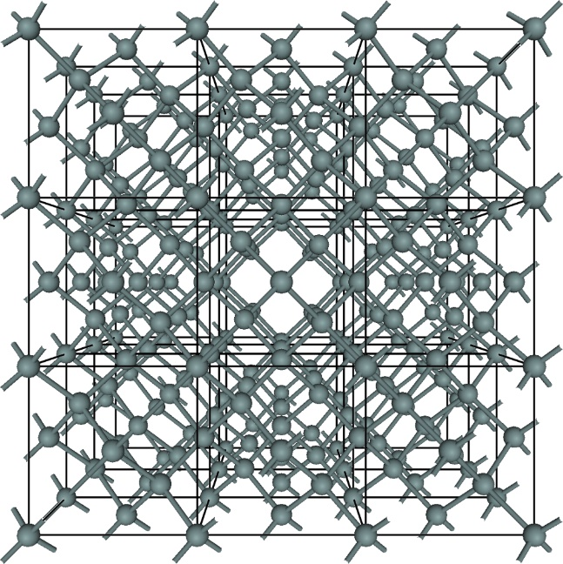
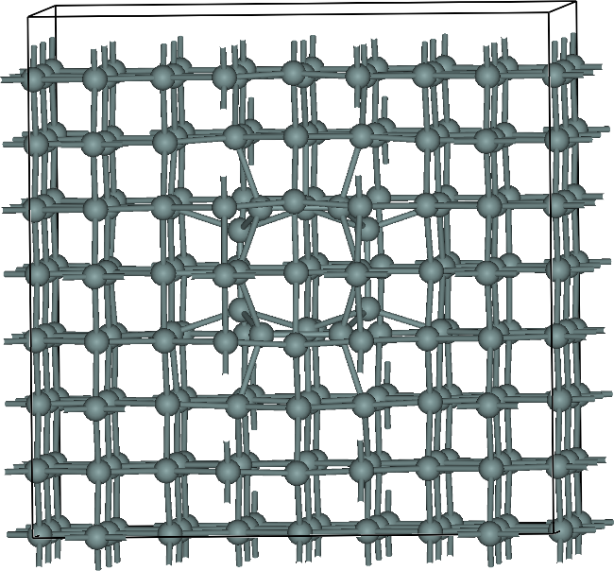
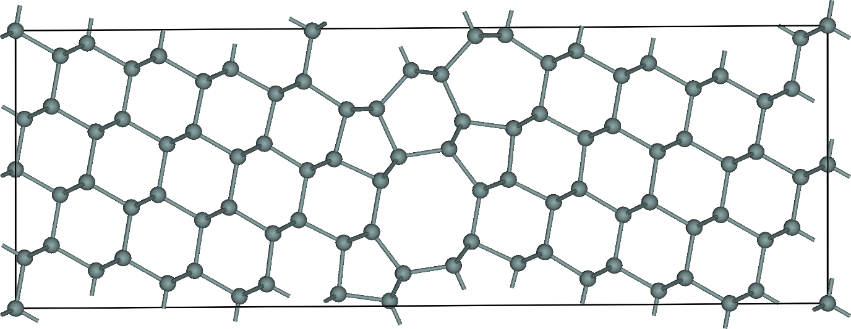
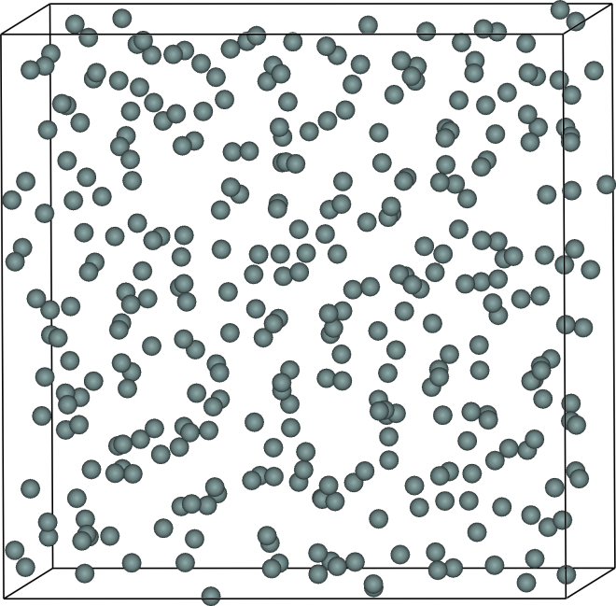
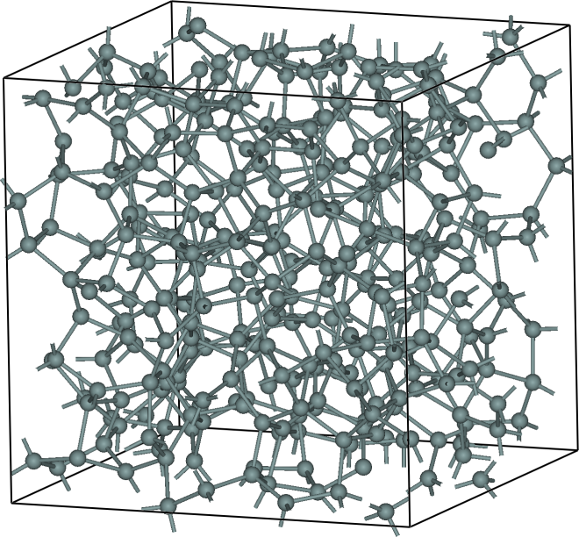
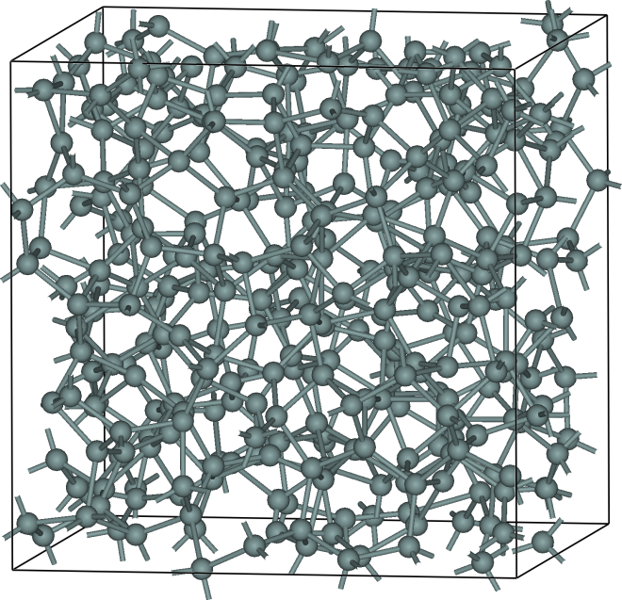
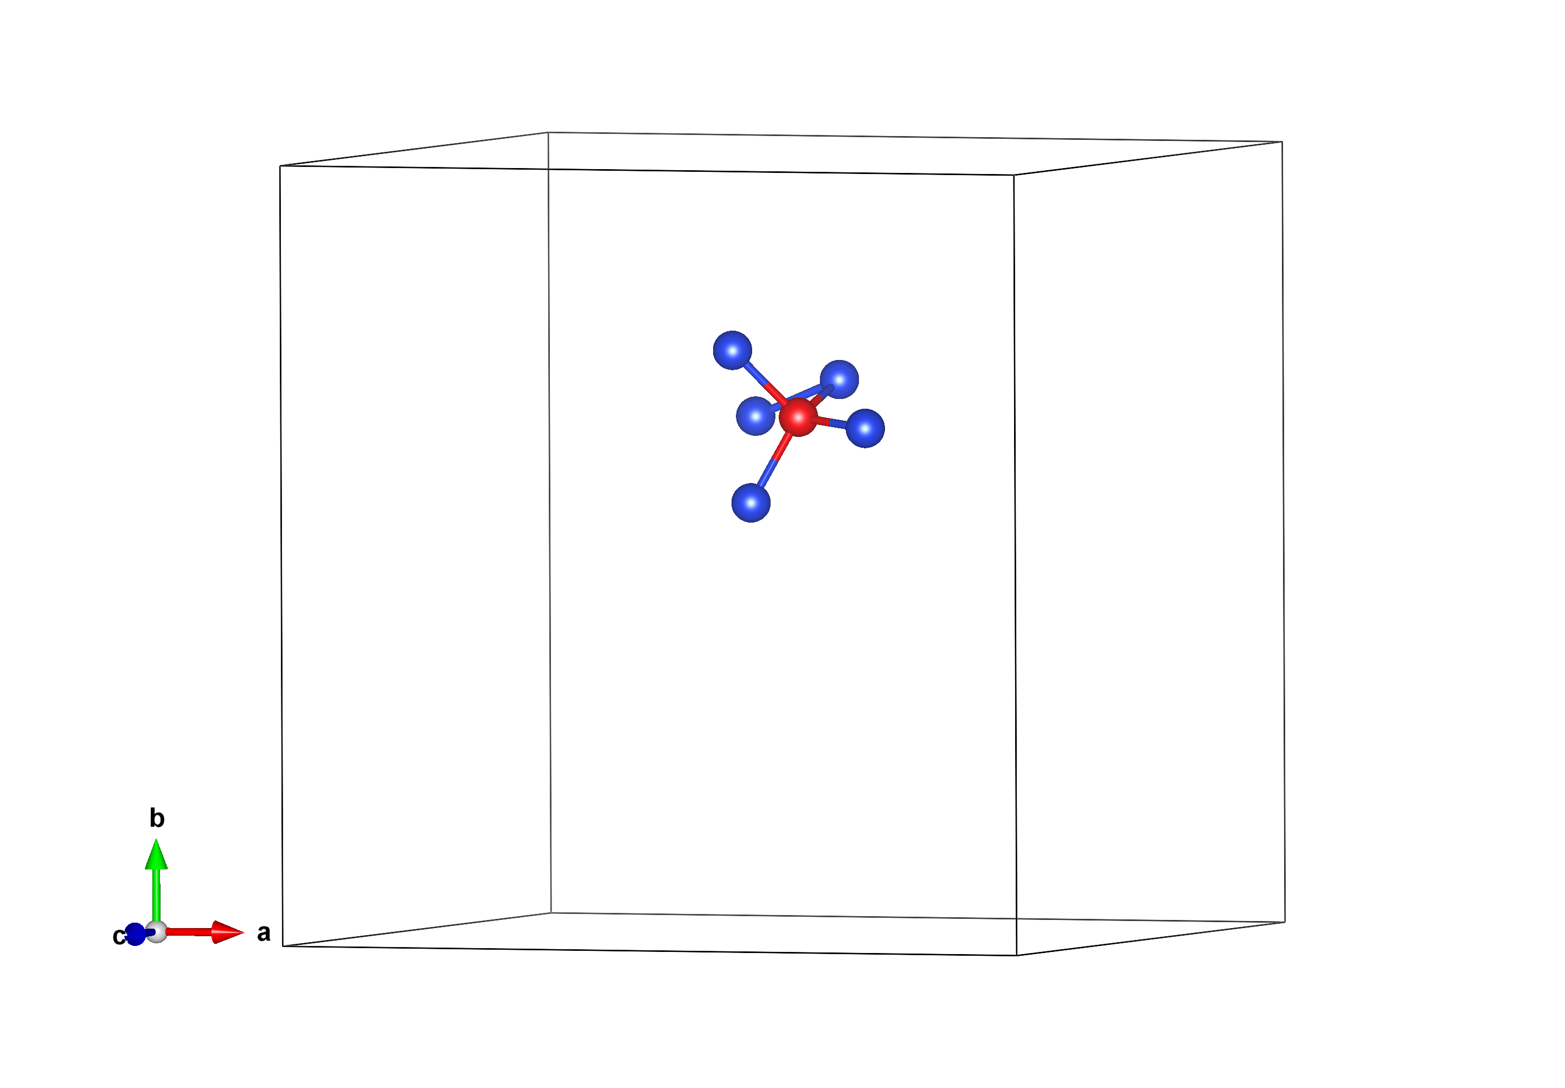
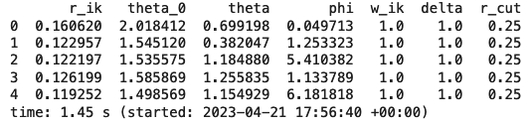
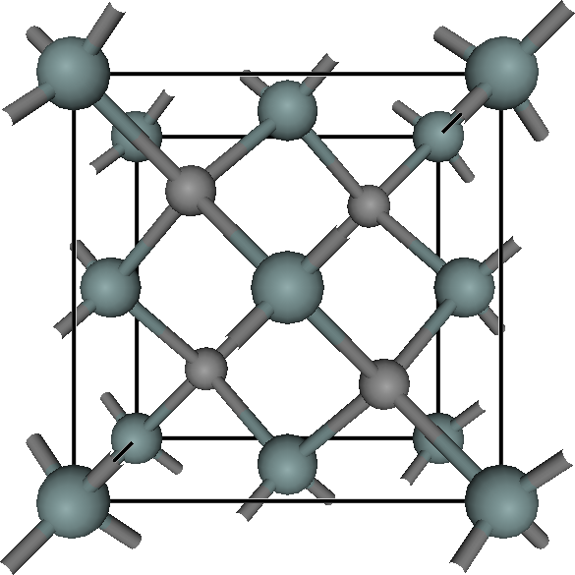
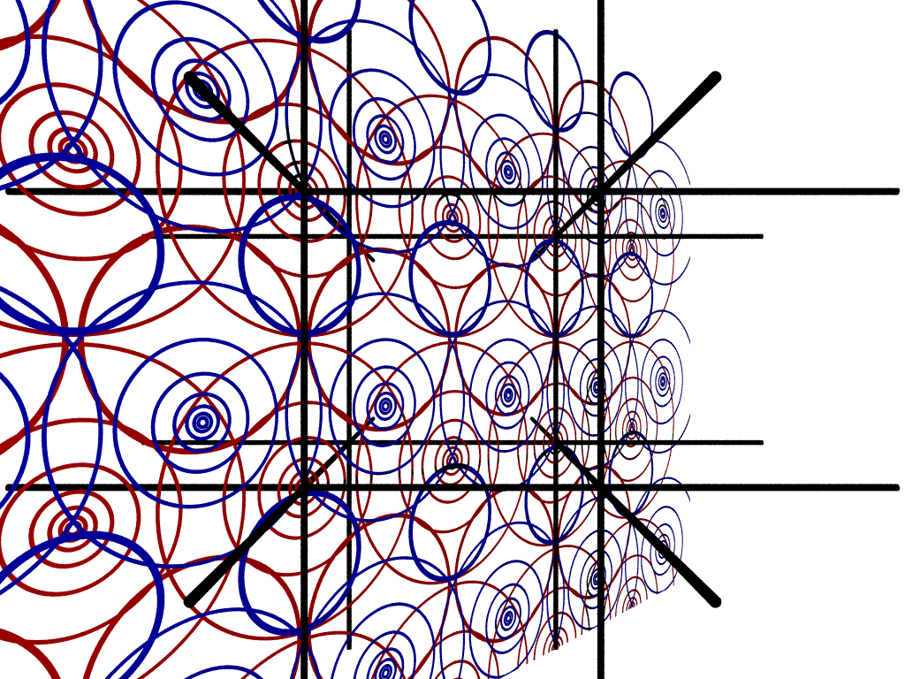
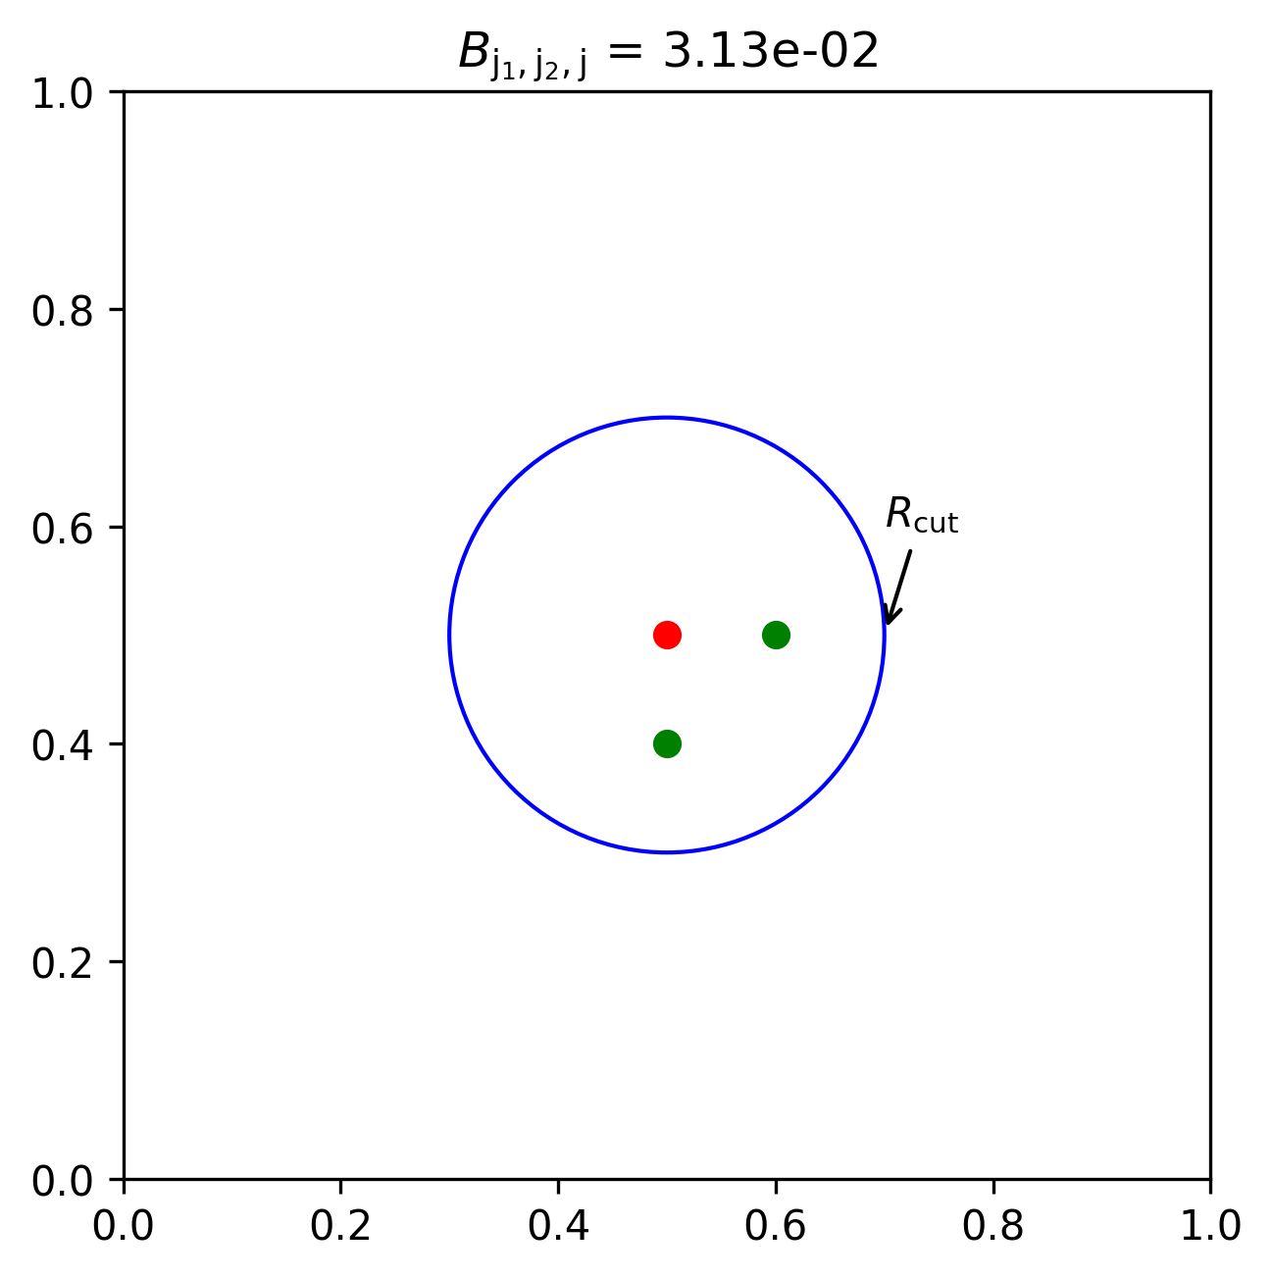
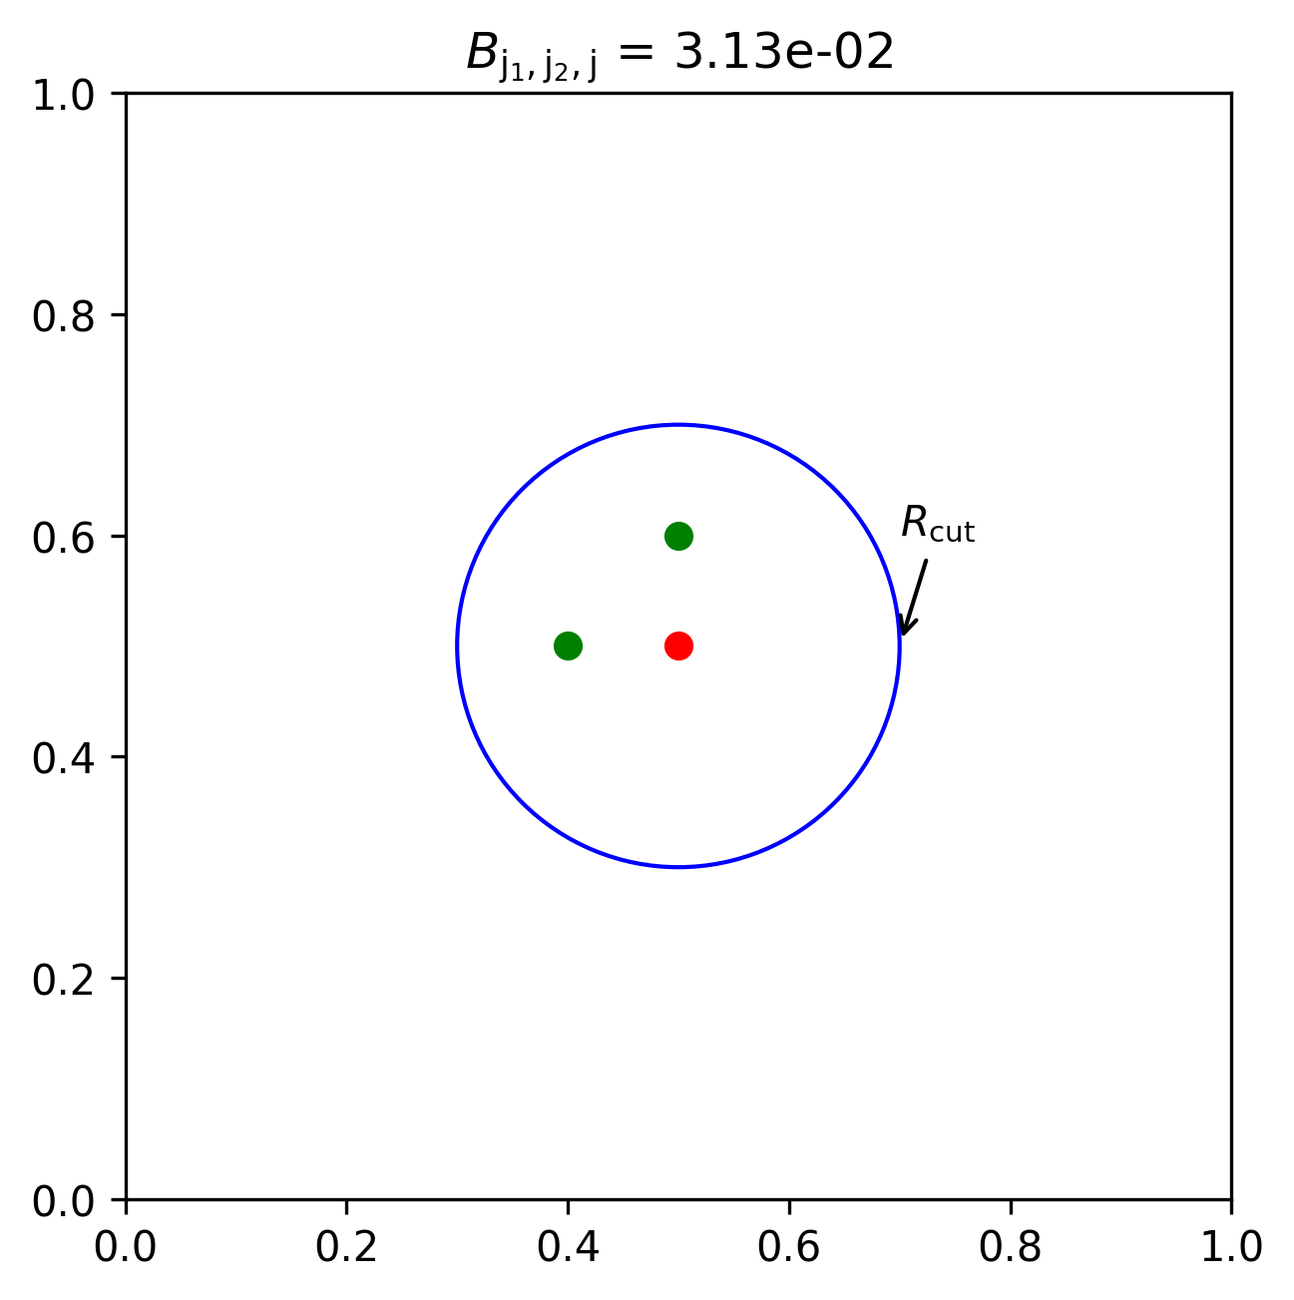
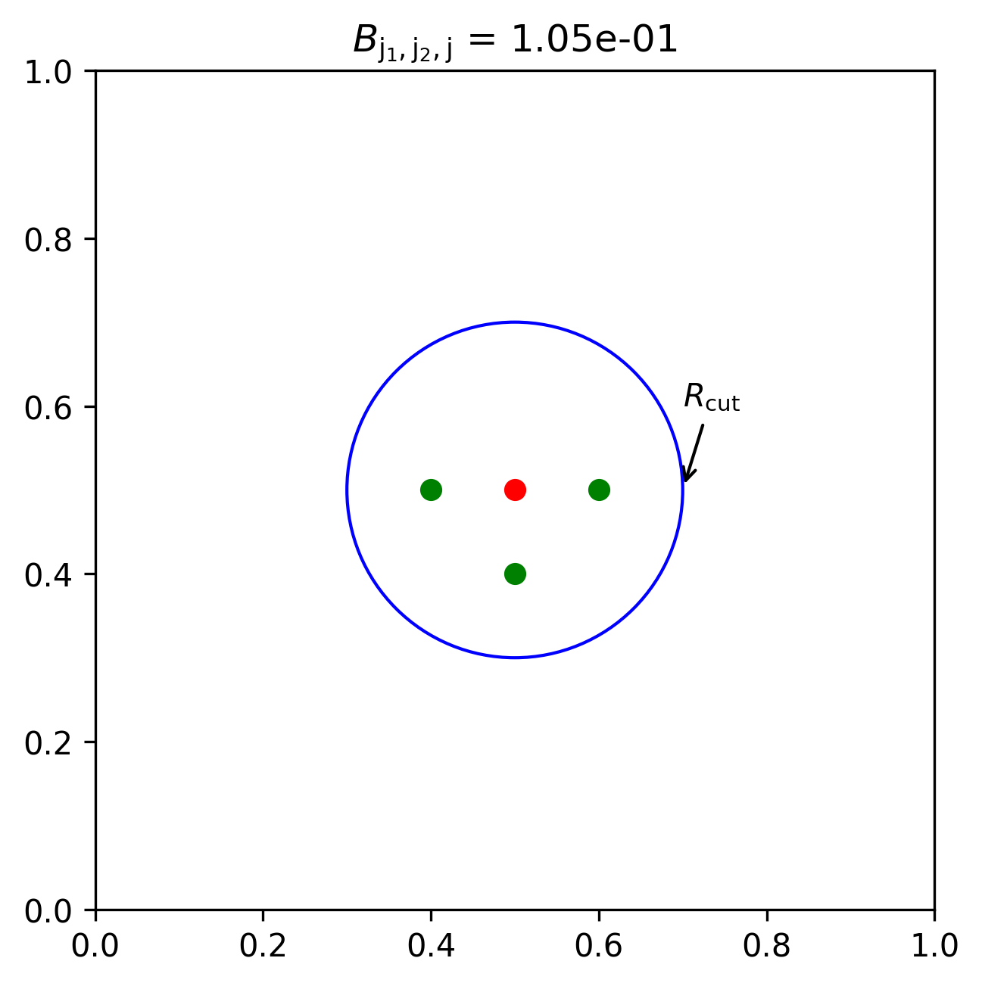
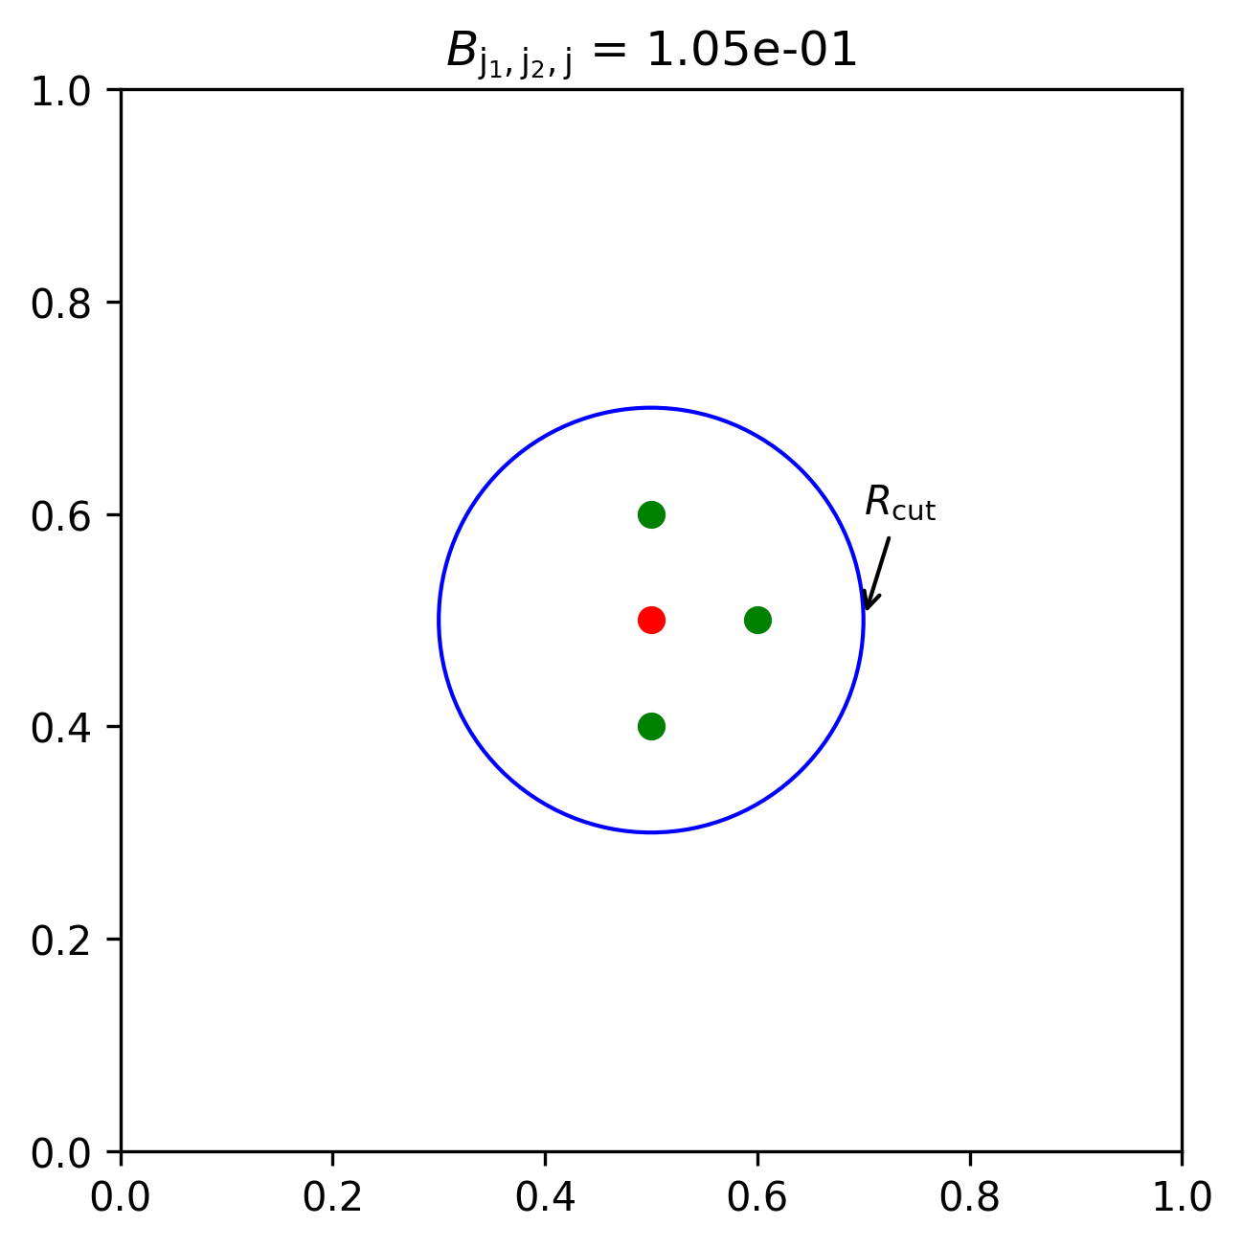
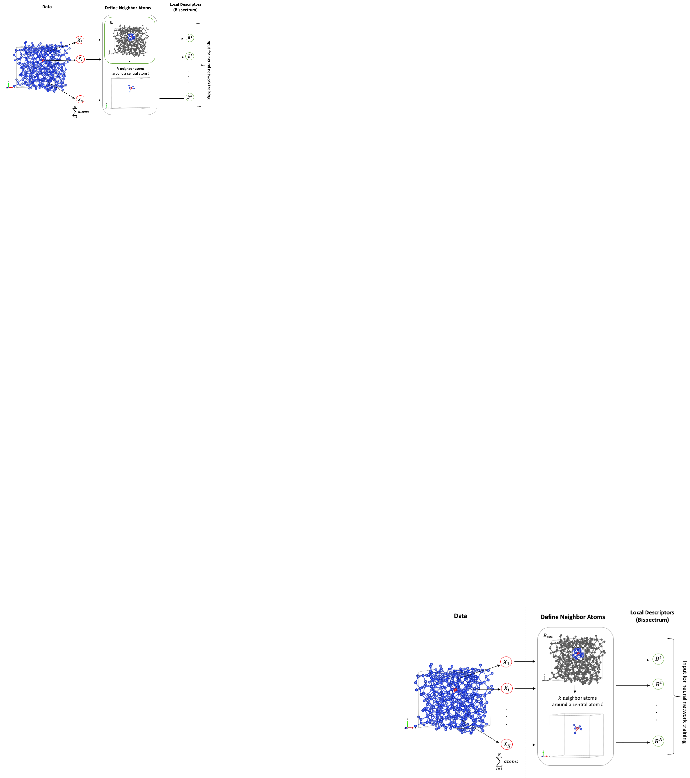
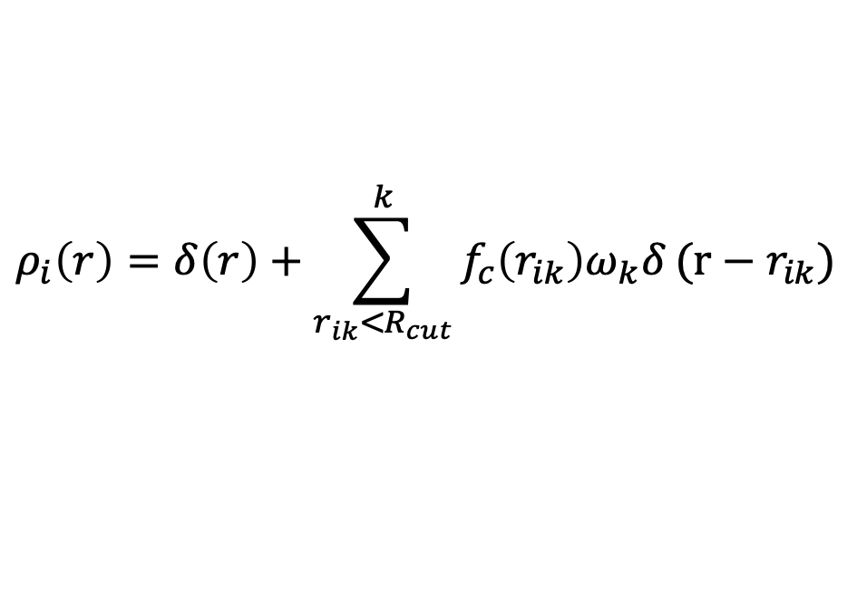
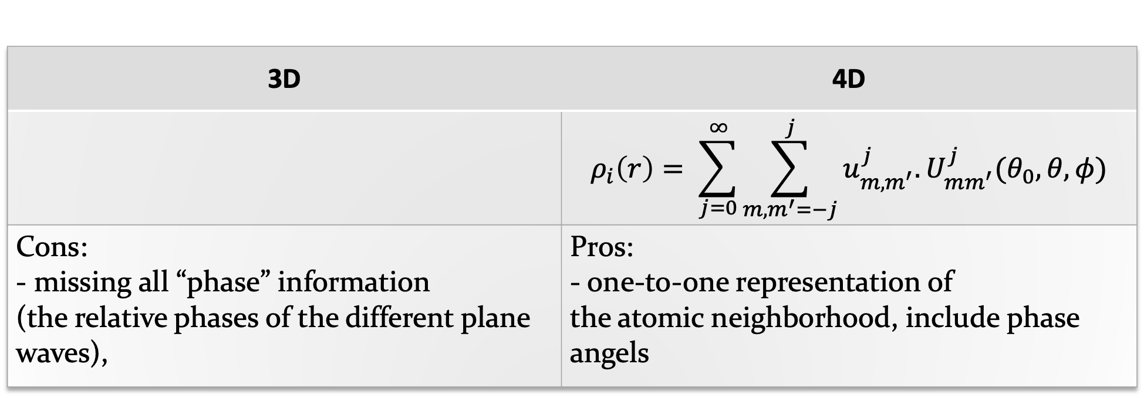
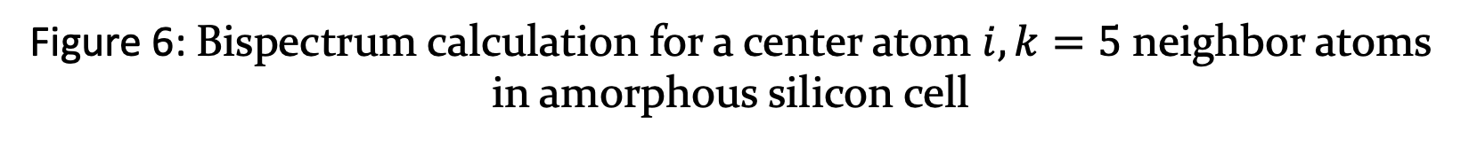
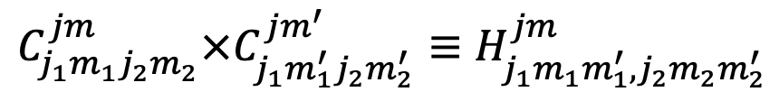
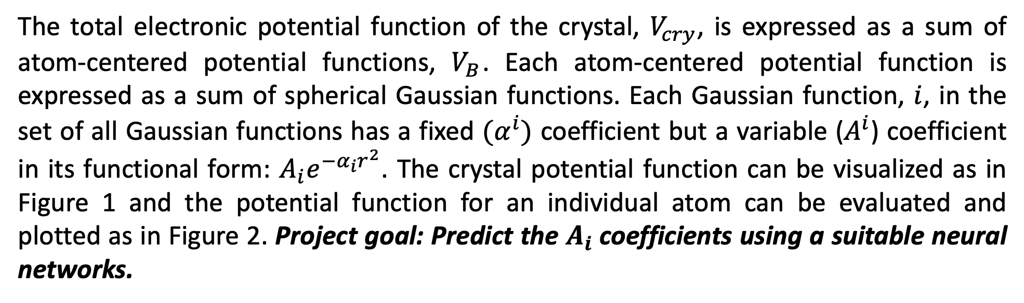
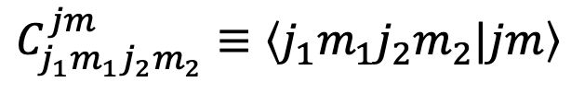
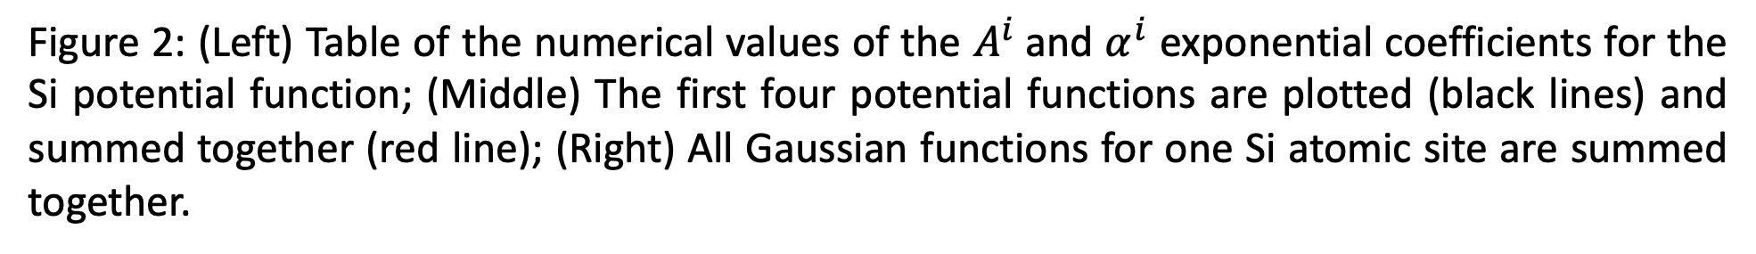
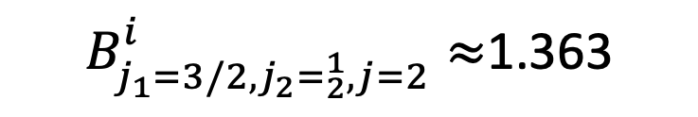
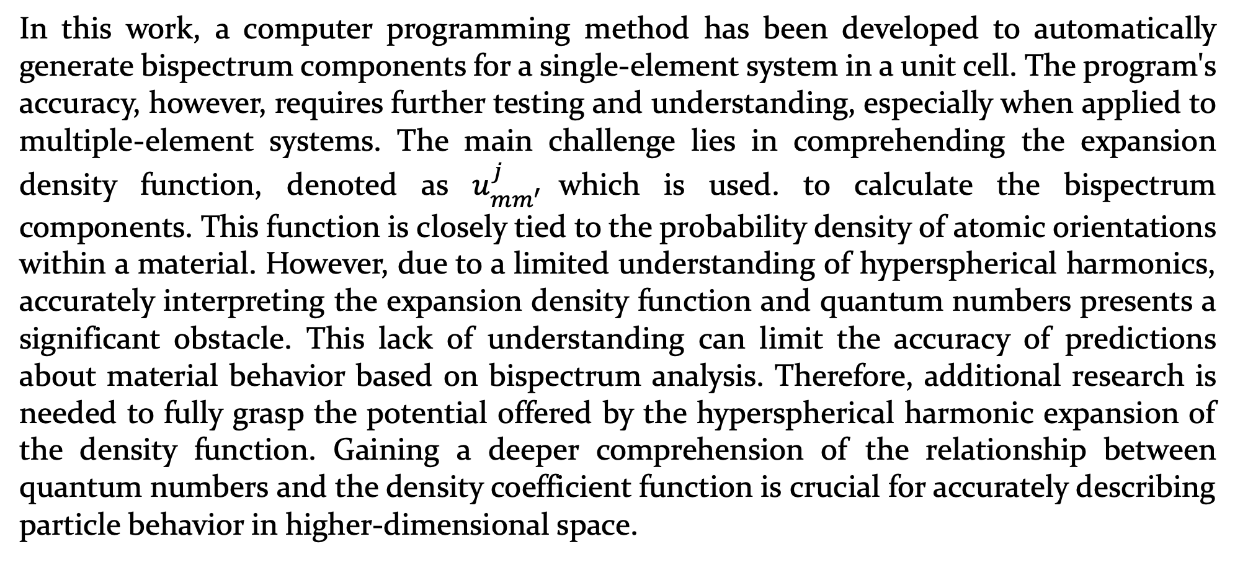
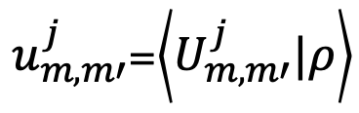
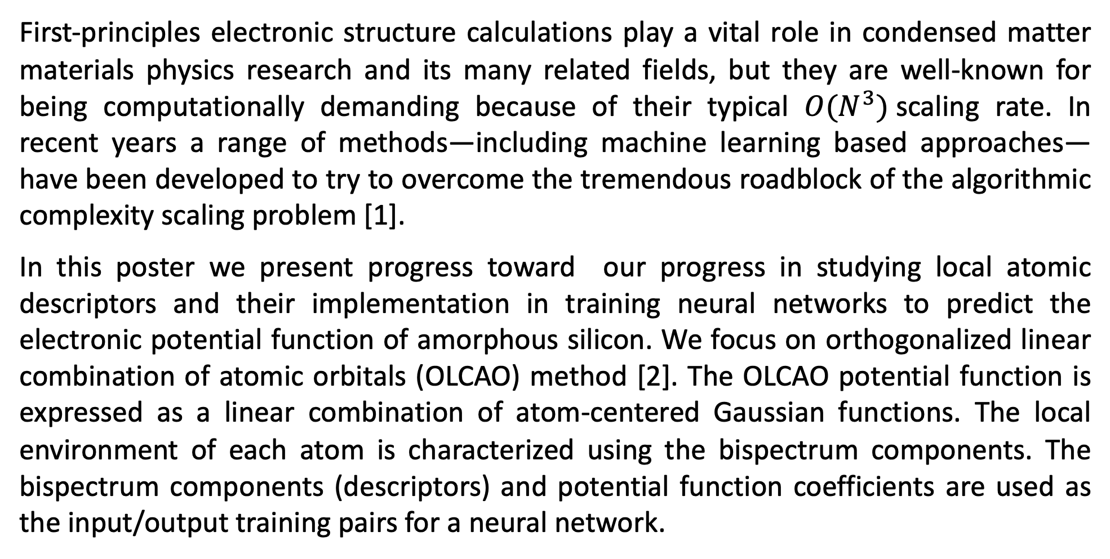
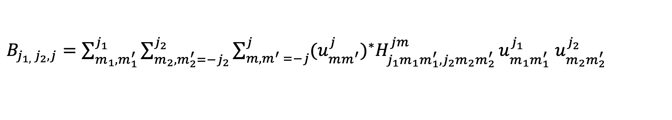
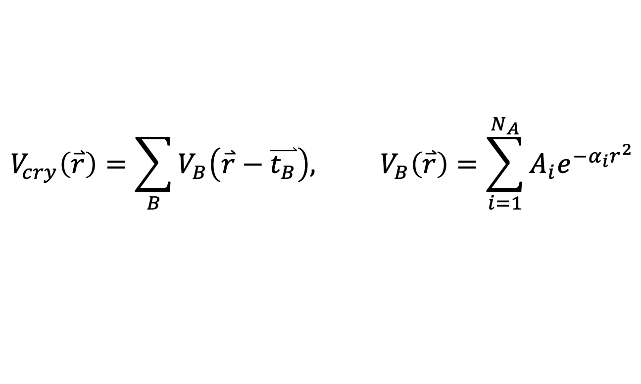
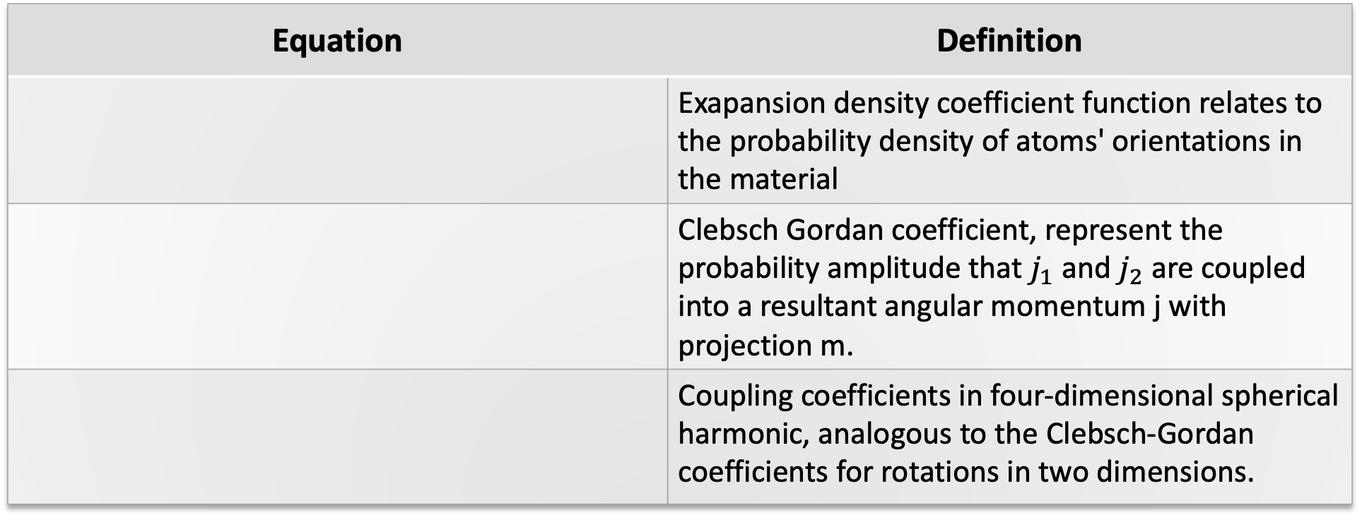
Machine Learning Potential Function Generation for ab initio Electronic Structure Calculations
Duong Hoang and Paul Rulis
Division of Energy, Matter, and Systems at the University of Missouri – Kansas City
Introduction
Neural Network
Systems
First-principles electronic structure calculations play a vital role in condensed matter materials physics research and its many related fields, but they are well-known for being computationally demanding because of their typical ${O(N}^{3})$scaling rate. In recent years a range of methods—including machine learning based approaches—have been developed to try to overcome the tremendous roadblock of the algorithmic complexity scaling problem [1].
In this poster we present progress toward our progress in studying local atomic descriptors and their implementation in training neural networks to predict the electronic potential function of amorphous silicon. We focus on orthogonalized linear combination of atomic orbitals (OLCAO) method [2]. The OLCAO potential function is expressed as a linear combination of atom-centered Gaussian functions. The local environment of each atom is characterized using the bispectrum components. The bispectrum components (descriptors) and potential function coefficients are used as the input/output training pairs for a neural network.
A collection of different pure silicon models are used for computing bispectrum components and used them as training input feature for ANN model training
Figure 3: Conceptual framework for a proposed neural network
OLCAO Potential Function
Bispectrum Components
Local density neighbor function in 3D/ 4D dimensional space
Figure 4: Six different models of pure silicon. (A) Crystalline silicon; (B) Crystalline silicon with an I4 set of self interstitial silicon; (C) A model of silicon with a passive defect; (D – F) Identically structured models of pure Si with uniform scaling of bond lengths from largest (Bottom Left) to the standard bond length (Bottom Middle) to compressed bond lengths (Bottom Right).
The total electronic potential function of the crystal, $V_{cry}$, is expressed as a sum of atom-centered potential functions, $V_{B}$. Each atom-centered potential function is expressed as a sum of spherical Gaussian functions. Each Gaussian function, $i$, in the set of all Gaussian functions has a fixed ${(α}^{i})$ coefficient but a variable ($A^{i}$) coefficient in its functional form: $A_{i}e^{−α_{i}r^{2}}$. The crystal potential function can be visualized as in Figure 1 and the potential function for an individual atom can be evaluated and plotted as in Figure 2. Project goal: Predict the $A_{i}$coefficients using a suitable neural networks.
3D | 4D
 | $$ρ_{i}\left(r\right)= \sum_{j=0}^{∞}{\sum_{m,m^{′}=−j}^{j}{u_{m,m^{′}}^{j}.U_{mm^{′}}^{j}(θ_{0},θ,φ)}}$$
Cons: - missing all “phase” information (the relative phases of the different plane waves), | Pros: - one-to-one representation of the atomic neighborhood, include phase angels
$$ρ_{i}\left(r\right)=δ\left(r\right)+\sum_{r_{ik}<R_{cut}}^{k}{f_{c}\left(r_{ik}\right)ω_{k}δ}(r−r_{ik})$$
Preliminary Results
$$V_{cry}\left(\overset{⃑}{r}\right)=\sum_{B}{V_{B}\left(\overset{⃑}{r}−\overset{⃑}{t_{B}}\right), V_{B}\left(\overset{⃑}{r}\right)=\sum_{i=1}^{N_{A}}{A_{i}e^{{−α}_{i}r^{2}}}}$$
Bispectrum – SO4
$B_{j_{1}=3/2, {j_{2}=}_{2}^{1},j=2}^{i}≈$1.363
The atomic environment descriptor proposed by Bartok et al [3], that have real value and remain invariant under translation, rotation, and permutation of atoms:
$B_{j_{1, }j_{2}, j}=\sum_{m_{1},m_{1}^{′}}^{j_{1}}{\sum_{m_{2},m_{2}^{′}={−j}_{2}}^{j_{2}}{\sum_{m,m^{′} =−j}^{j}{{(u_{mm^{′}}^{j})}^{∗}H_{j_{1}m_{1}m_{1}^{′},j_{2}m_{2}m_{2}^{′}}^{jm}}u_{m_{1}m_{1}^{′}}^{j_{1}}}}$ $u_{m_{2}m_{2}^{′}}^{j_{2}}$
Figure 6: Bispectrum calculation for a center atom $i, k=5$neighbor atoms in amorphous silicon cell
Equation | Definition
 | Exapansion density coefficient function relates to the probability density of atoms' orientations in the material
 | Clebsch Gordan coefficient, represent the probability amplitude that $j_{1}$ and $j_{2}$ are coupled into a resultant angular momentum j with projection m.
 | Coupling coefficients in four-dimensional spherical harmonic, analogous to the Clebsch-Gordan coefficients for rotations in two dimensions.
$u_{m,m′}^{j}$=$\left\langle U_{m,m′}^{j}|ρ\right\rangle$
$$C_{j_{1}m_{1}j_{2}m_{2}}^{jm}≡\left\langle j_{1}m_{1}j_{2}m_{2}|jm\right\rangle$$
$$C_{j_{1}m_{1}j_{2}m_{2}}^{jm}×C_{j_{1}m_{1}^{′}j_{2}m_{2}^{′}}^{jm^{′}}≡H_{j_{1}m_{1}m_{1}^{′},j_{2}m_{2}m_{2}^{′}}^{jm}$$
Figure 6: Bispectrum calculation with modified neighbor atom positions
Figure 1: (Left) Ball and stick model of crystalline Silicon Carbide with large balls for the Silicon (Si) and small balls for the C. (Right) A cross sectional slice of the potential function for Silicon Carbide showing the atom centered spherical Gaussians at each atomic site.
Conclusion
Table 1: Mathematical equations definition for bispectrum calculation
In this work, a computer programming method has been developed to automatically generate bispectrum components for a single-element system in a unit cell. The program's accuracy, however, requires further testing and understanding, especially when applied to multiple-element systems. The main challenge lies in comprehending the expansion density function, denoted as $u_{mm^{′}}^{j}$which is used. to calculate the bispectrum components. This function is closely tied to the probability density of atomic orientations within a material. However, due to a limited understanding of hyperspherical harmonics, accurately interpreting the expansion density function and quantum numbers presents a significant obstacle. This lack of understanding can limit the accuracy of predictions about material behavior based on bispectrum analysis. Therefore, additional research is needed to fully grasp the potential offered by the hyperspherical harmonic expansion of the density function. Gaining a deeper comprehension of the relationship between quantum numbers and the density coefficient function is crucial for accurately describing particle behavior in higher-dimensional space.
Coefficients (A_{i}) Exp Coeffs (α_{i})
---------------------------------------------------------
#1 -0.60672619E+00 0.15000000E+00
#2 -0.12407671E+01 0.42758111E+00
#3 -0.36166706E+01 0.12188374E+01
#4 -0.91724811E+01 0.34743455E+01
#5 -0.16959754E+02 0.99037634E+01
#6 0.40745139E+02 0.28231081E+02
#7 0.12733590E+02 0.80473846E+02
#8 0.10442423E+02 0.22939397E+03
#9 -0.19109966E-01 0.65389686E+03
#10 0.54010939E+01 0.18639596E+04
#11 -0.42032006E+01 0.53132928E+04
#12 0.66156017E+01 0.15145758E+05
#13 -0.74064920E+01 0.43173599E+05
#14 0.91870114E+01 0.12306810E+06
#15 -0.92689314E+01 0.35081063E+06
#16 0.63220401E+01 0.10000000E+07
Figure 2: (Left) Table of the numerical values of the $A^{i}$and $α^{i}$ exponential coefficients for the Si potential function; (Middle) The first four potential functions are plotted (black lines) and summed together (red line); (Right) All Gaussian functions for one Si atomic site are summed together.
References
Figure 4: Bispectrum calculation framework
[1] Kulik, H. J., Welborn, M., Marom, N., Tkatchenko, A., Hennig, R. G., Kästner, J., Lilienfeld, O. A. v., & Yang, T. (2022). Roadmap on Machine learning in electronic structure. Electronic Structure, 4, 023004. https://doi.org/10.1088/2516-1075/ac572f
[2] Ching, W.-Y., & Rulis, P. (2012). Basic Theory and Techniques of the OLCAO Method. In A. Zunger (Ed.), Modern Methods of Crystal Structure Prediction (pp. 61-83). Oxford University Press. https://doi.org/10.1093/acprof:oso/9780199575800.003.0003
Copyright © 2023 UMKC
Work supported by the Computational Physics Group and
The UMKC Physics and Astronomy Program
Contact us at: rulisp@umkc.edu , dtht2d@umsystem.edu

